Slide 1
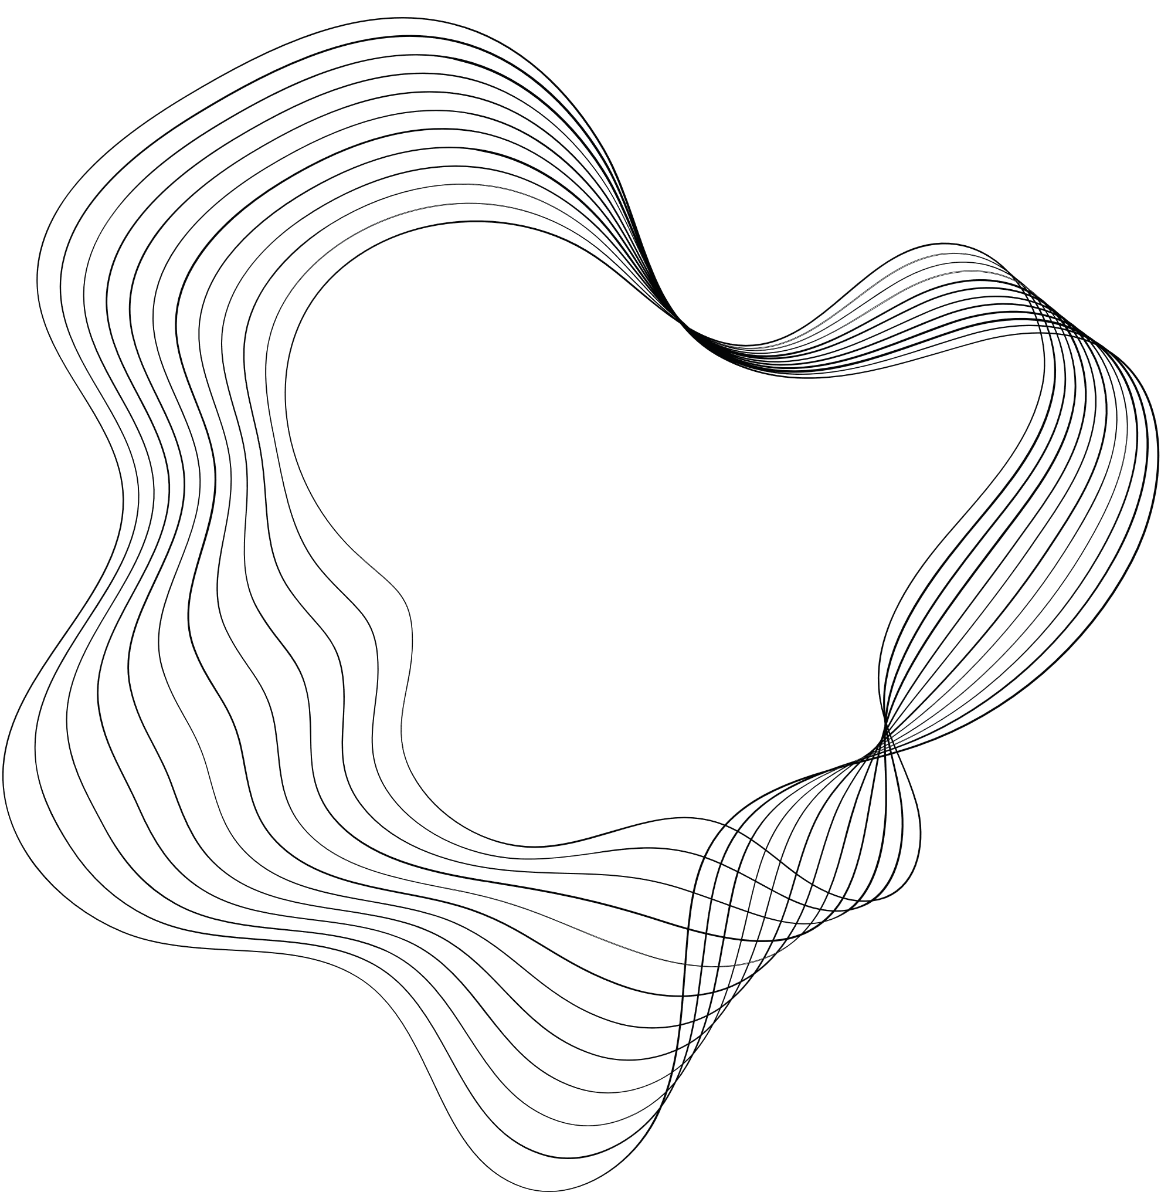

Cross-Domain Image-to-Image Translation
with VQGAN and BBDM
11/06/2024

Slide 2

OUR TEAM
Ashrakat Saeed
Mariam Ayman
Abdelrahman Said
Mostafa Atef
Ahmed Rashed
Ceo Of Ingoude Company
Ceo Of Ingoude Company
Drew Holloway

Slide 3

CONTENT
01
INTRODUCTION
02
RELATED WORK
03
METHODOLOGY
04
RESULTS
05
DISCUSSION

Slide 4

INTRODUCTION
Image to image translation is a problem of learning mapping Function between two distinct image domains.
I2I has Variety of application and solve problems in many of them like in style transfer, semantic image analysis or data augmentation, and image restoration in super-resolution, colorization, inpainting, and sketch-to-image translation.

Slide 5
INTRODUCTION
Pix2pix project and use CycleGANs in Image to Image Translation:
Hard to Train
Drop Modes
Traditional Diffusion Model Method:
very poor generalization
doesn’t guarantee that the final diffusion result yields the desired conditional distribution.

Slide 6
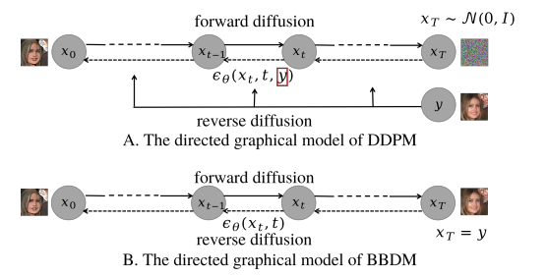
INTRODUCTION
Our method models the mapping between the input and output domains through a Brownian Bridge stochastic process, directly without conditional generation, in contrast to existing diffusion methods.
Performing the diffusion process in the same latent space and sample from latent space of VQGAN.

Slide 7
RELATED WORK
U-GAT-IT
Style Diffusion
DiffI2I
RL-I2IT

Slide 8
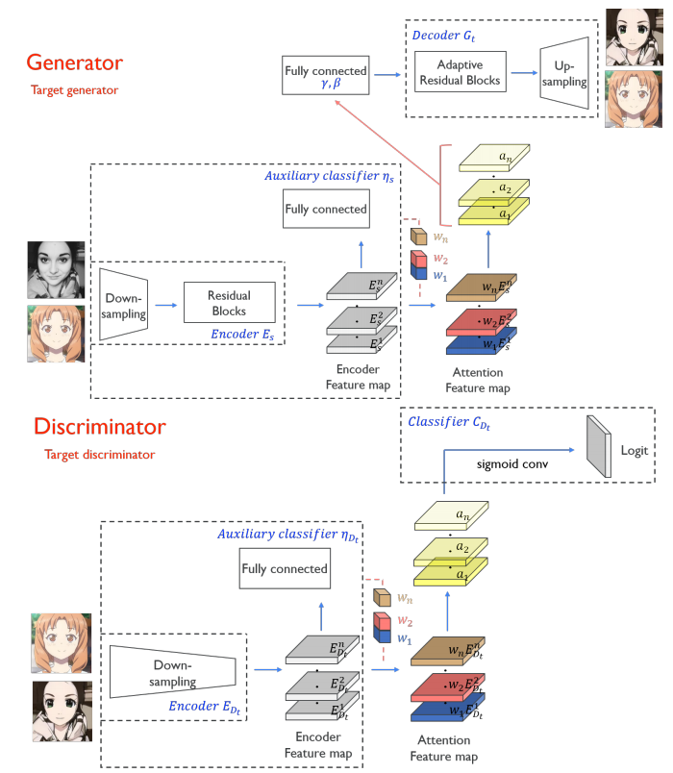
U-GAT-IT
Architecture
Innovative attention module along with a new learnable normalization function (AdaLIN).
Contributions
Can translate geometric transformations between domains.
AdaLIN enables the attention module to flexibly control the extent of changes in shape and texture.
Limitations
Fixed network architecture.
Computational complexity.

Slide 9
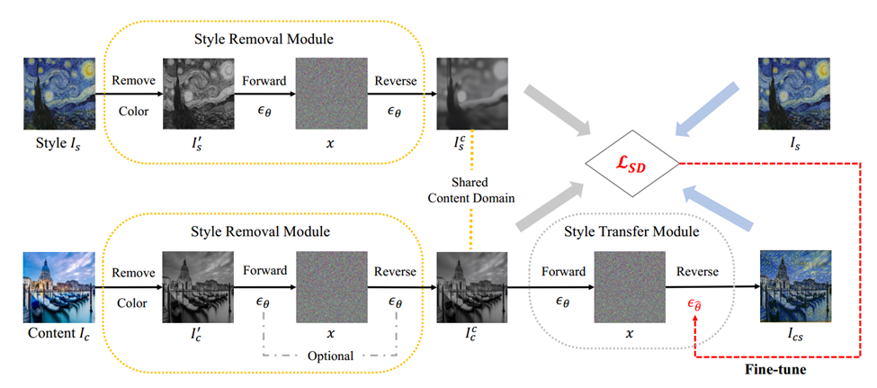
STYLEDIFFUSION
Architecture
Diffusion-based Style Removal Module, Diffusion-based Style Transfer Module, CLIP-based Style Disentanglement Loss.
Contributions
Control over C-S disentanglement.
Robust to mode collapse.
Limitations
Need for fine-tuning.
Efficiency issues.
Vanishing of salient content.

Slide 10
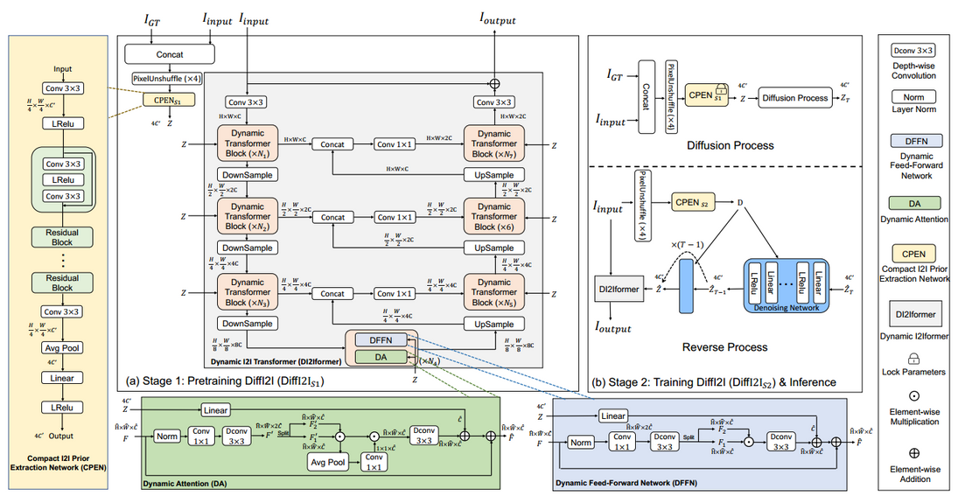
DIFFI2I
Architecture
Compact image-to-image prior extraction network, dynamic image-to-image transformer, denoising network.
Contributions
CPEN capture lower dimension representation.
Addition of attention.
Joint optimization of denoising network and the decoder.
Limitations
Need for iterative diffusion process.
Training complexity.
Impact of noise introduction.

Slide 11
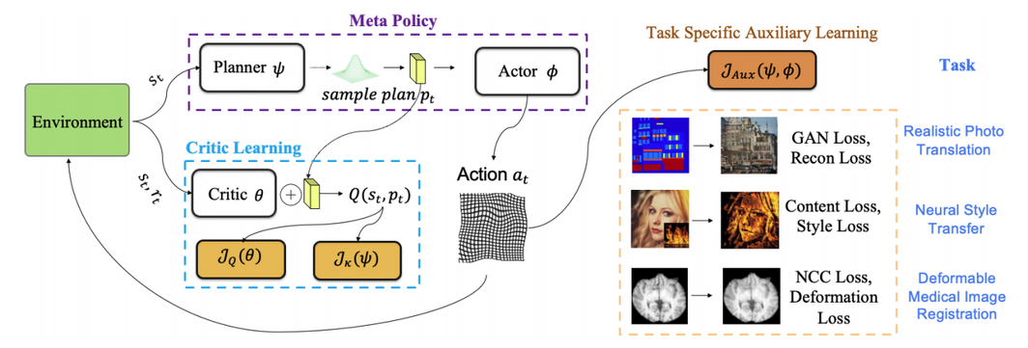
RL-I2IT
Architecture
Planner, Actor, Critic
Contributions
Addition of planner to help the actor.
Critic evaluates the plan rather than the action.
Limitations
Single-Style NST Limitation.
Hyperparameter Dependency.
High-dimensional continuous action handling.
Limited generalization to other tasks.

Slide 12

METHODOLODY
To explain each part of our project and our model

Slide 13

Approach:
GAN Architecture: Utilizes Vector Quantized Generative Adversarial Network (VQGAN) for initial image representation.
Diffusion Model (BBDM): Integrates Brownian Bridge Diffusion Model (BBDM) for refining and enhancing image quality.
Latent Space: Explores and utilizes discrete latent space generated by VQGAN for domain enhancement.
Dataset:
CelebAMask-HQ: High-resolution facial images annotated with masks, providing extensive and diverse data for training and evaluation.

Slide 14
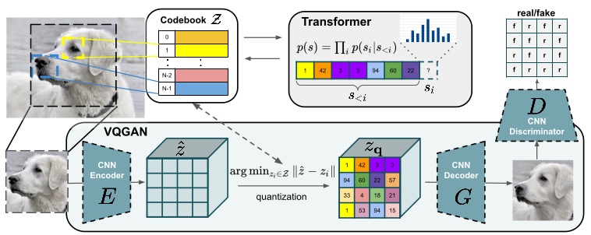
We propose to accomplish the diffusion process in the latent space of the popular pre-trained VQGAN model
VQGAN Architecture

Slide 15
Conditional Diffusion Models versus BBDM
Most of the conditional diffusion models suffer from poor model generalization, and can only be adapted to some specific applications where the conditional input has high similarity with the output, such as inpainting and super-resolution.
These methods treat image-to-image translation as conditional image generation by integrating the encoded feature of the reference image into the U-Net in the reverse process to guide the diffusion towards the target domain. Despite some practical success, the above condition mechanism does not have a clear theoretical guarantee that the final diffusion result yields the desired conditional distribution.

Slide 16
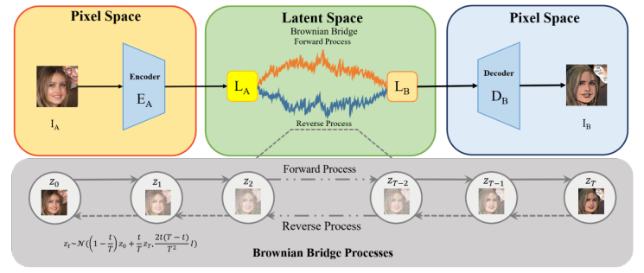
Brownian Bridge Diffusion Model (BBDM)
The proposed BBDM method models image-to-image translation as a Brownian Bridge stochastic process.
Unlike traditional diffusion methods, which treat translation as a conditional generation process, BBDM directly maps input to output domains.
BBDM Architecture

Slide 17
Forward and Reverse Processes
Forward Process:
The forward diffusion process starts from a clean data point x0​ and progresses to a latent variable xT, modeled as a Gaussian distribution. The forward process is defined to maintain a marginal distribution at each step.
Reverse Process:
In the reverse process, the model starts from the conditional input xT=y and predicts the previous state from xT. This is unlike existing methods which start from pure noise and conditionally guide the reverse diffusion.

Slide 18
DEMO

Slide 19
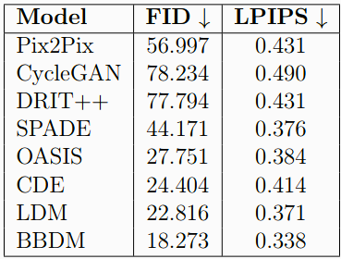
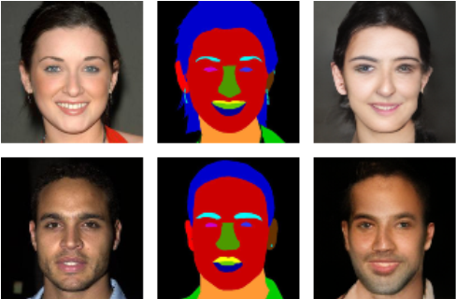
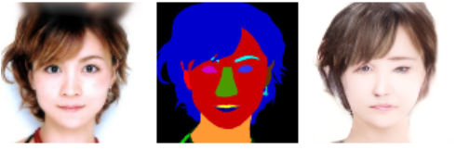
RESULTS
Model Performance on CelebAMask-HQ Dataset
BBDM Sample Result

Slide 20
DISCUSSION
Findings
The BBDM shows significant improvements in image quality and diversity over traditional GAN-based methods like Pix2Pix, CycleGAN, and DRIT++.
BBDM was applied to the semantic synthesis challenge using the CelebAMaskHQ dataset, and outperformed baseline models in key quantitative metrics like LPIPS and FID.
Limitations
High computational demand for BBDM training and inference, making it challenging for real-time or low-power applications.

Slide 21
DISCUSSION
2. Limitations(CON.)
Reliance on the CelebAMaskHQ dataset limits generalizability; further testing on diverse datasets is needed.
Current evaluation metrics (FID, LPIPS) may not fully capture user satisfaction; human evaluation could provide additional insights.
3. Implications
Diffusion-based models like BBDM could surpass GAN-based models for high-fidelity image synthesis.
Potential applications in virtual reality, medical imaging, game design, and animation, where high-quality, diverse images are crucial.
Improved facial recognition and enhancement technologies through realistic facial image generation.

Slide 22

THANK'S FOR Listening
Do You Have Any Questions?

